Slide 1
The Mad Hedge Fund Trader “Lighting a Fire”
With John Thomas from San Francisco, CA, February 15, 2017 www.madhedgefundtrader.com
Notes:
*

Slide 2
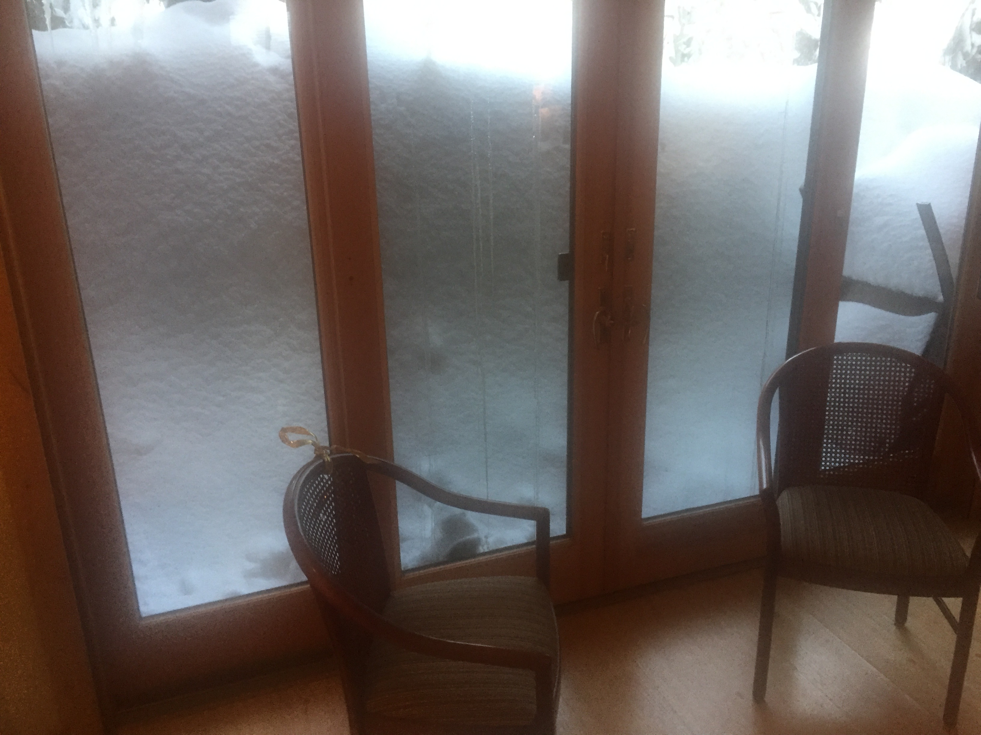

Slide 3
Second Edition
Is Out!
In the Store Now for $49
Sectors and Stocks that Will Lead the Market for the Next 20 Years
https://members.madhedgefundtrader.com/roaring-twenties-book/

Slide 4
Trade Alert Performance Best 4 Weeks of the Past 12 months-New All Time High!!
*January +9.35% Final *July +0.67% Final *February +4.69% MTD *August +7.52% Final *March -2.42% Final *September +0.27% Final *April -2.10% Final *October +8.13% Final *May +4.38% Final *November 4.37% Final *June -0.56% Final *December +.84% Final *2017 Year to Date 14.04% compared to 3.17% for the Dow Average 8 Consecutive Profitable Months! *Trailing 1 year return +40.43%, +232.60% since inception, *Average annualized return of 37.78%

Slide 5
Portfolio Review Small Unhedged Short Portfolio on Top of Big Market Moves 80% Cash
Current Capital at Risk
Risk On
World is Getting Better
Risk Off
World is Getting Worse
(TLT) 3/$114-$117 call spread | -10.00%
(SLV) 3/$15.50-$16.00 call spread | -10.00%
Total Net Position | -20.00%
Expiration P&L 16.85%

Slide 6
Trailing One-Year Return Daily Audited Performance-Was I Just Lucky? +40.43%

Slide 7
Seven Year Daily Audited Performance Averaged Annualized Return +37.78%

Slide 8
If you are not up + 40.43% in the past 12 months, as I am, you are reading the wrong newsletter, or following the wrong trade mentoring service!

Slide 9
Mad Options Trader
*6 Huge consecutive trading months in the weekly options *Demand for the new $2,000 a year service has been overwhelming *Email Nancy in Customer Support at support@madhedgefundtrader.com and put “MOT Upgrade” in the subject line to add the service *Nancy will calculate a pro rata credit for the balance of your remaining subscription, and then bill you for your new subscription + MOT

Slide 10
Integrating Top Gun and the Mad hedge Fund Trader Add It all Together to Boost Your Results
Top Gun
Mad Hedge Fund Trader
US Equities
US and International Equities Bonds Foreign Exchange Energy Commodities Precious Metals Real Estate
Sophisticated options tactics, leaps, weekly expirations, with some front month and long term expirations
Simple options strategies, Medium term 10-60 day expirations
Technical analysis
Daily long term fundamental research newsletter

Slide 11
Mad Options Trader Performance Four Year Average Annual Return of 113.25%

Slide 12
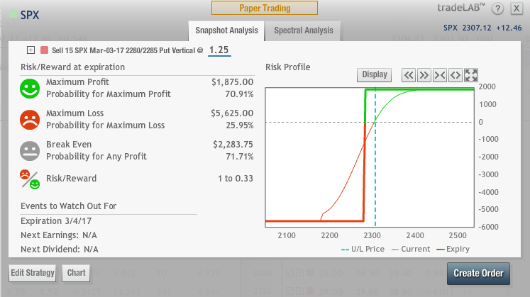
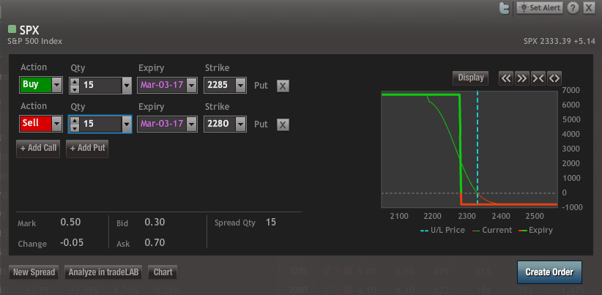
(SPX) Bull Put Spread A Bet That the S&P 500 Will Go Flat or Rise in 15 Trading Days
Buy the March 4 (SPX) $2285 puts at Sell short the March 4 (SPX) $2280 puts Net Proceeds………………………………………………..$1.25 Credit Current mark to market…………………………………….$0.50 Profit………………………………………………………….$0.75 ($0.75 X 100 X 15 contracts) = +$1,125

Slide 13
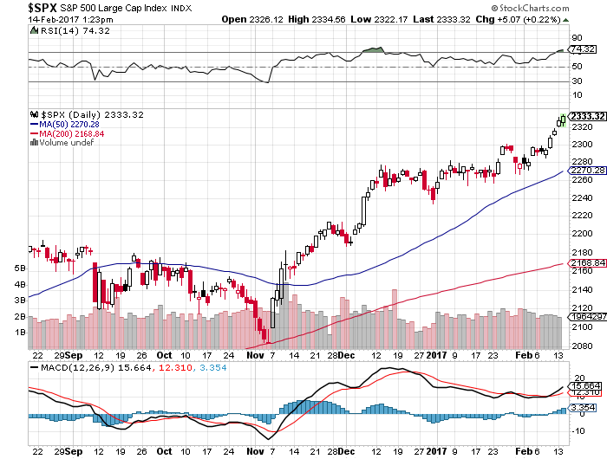

Slide 14
The MOT Followers Love It!
“Booked over $60,000 on two (GS) leaps over three months. Thanks Whiz!” -Harry “I have five (GS) long call diagonals. Since October I’m up $9,088.76 net, about 25% in five months. Happy ☺ -Mike “+$64,000 on 10 contracts” -Michael

Slide 15
The 30,000 Foot View The Really Simple Big Picture
*Markets are screaming for tax cuts and deregulation, every hint is worth a new all time high *Markets are giving the administration the benefit of the doubt, with no substantial selloff since the election *Keep hammering away at “RISK ON” asset classes and sectors until proven otherwise *Markets will go from very overbought to insanely overbought -Feb 18 State of the Union *Look for more “time” and not “price” corrections, as markets trade between overbought and extremely overbought

Slide 16
The Method to My Madness
*Piled back into aggressive long positions, but with more hedges this time, then took quick profits *Staying short dated to control risk and protect against a sudden reversal *Keep a position in precious metals as an anti Trump hedge *Swinging for singles, not home runs, don’t let the new world order make you greedy *Trying to rack up as much performance now while it is still easy

Slide 17
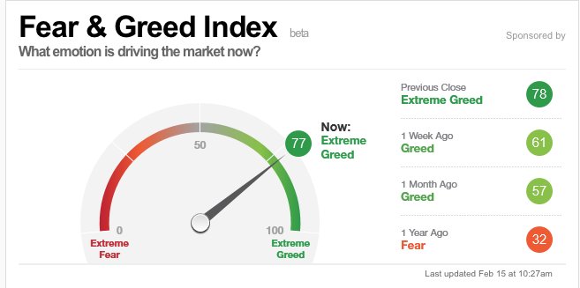
Risk is High-Moving Back Up to “SELL” Territory

Slide 18
The Global Economy-Recovery
*The global synchronized recovery is here *Stock markets around the world are breaking to new highs, creating a global wealth effect *US Producer Price Index comes in at 0.6%, 1.6% YOY, double expected, inflation is back, US Small Business Optimism hits the highest level since 2004 *Bank of Japan launches massive JGB bond buy to keep ten year yields at 0%, amounts to more QE *Chinese reserves fall below $3 trillion, lowest in 5 years as central bank rushes to prevent currency fall, PPI up 7% YOY, where inflation starts *German Industrial Production craters 3%, heightening European weakness, but inflation hits 3 year high at 1.6% from weak Euro

Slide 19
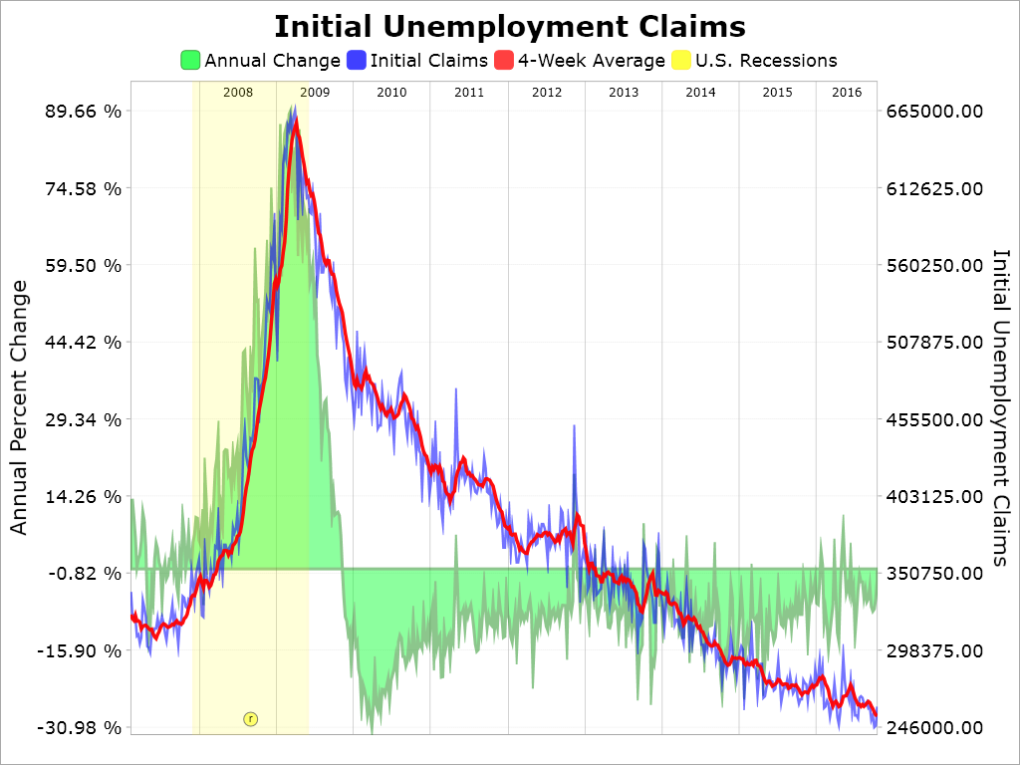
Weekly Jobless Claims –The Most Important Statistic -12,000 to 234,000- New all time low!

Slide 20
Stocks-Lighting a Fire
*Hedge fund stock longs hit 2 year high, with focus on banks, technology, energy, and infrastructure, more to come? *But tweet risk is ever present for the “bad” industries *US stock market cap tops $20 trillion for the first time *Stock buyback tops $5 trillion since 2012, repatriation will add another $2.5 trillion, is hugely market positive *Fed governor Dan Tarullo resigns, oversaw bank regulation, light a fire under bank shares *Any sign of a slowing economy could have an outsized downside effect on stock prices *All price gains since November 8 have been from price earnings multiple expansion, creates a very high risk market

Slide 21
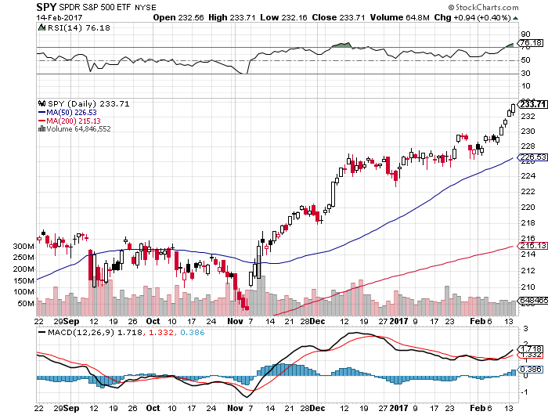
S&P 500- took profits on long 11/$220-$223 bear put spread took profits on long 1/$219-$222 bull call spread stopped out of 2/$233-$236 vertical bear put spread near cost

Slide 22
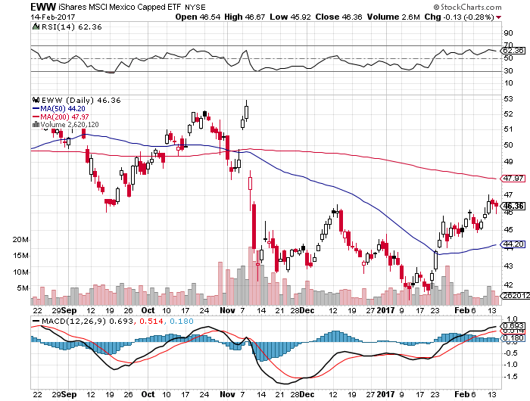
iShares MSCI Mexico ETF (EWW)-Trump Policy Benchmark

Slide 23
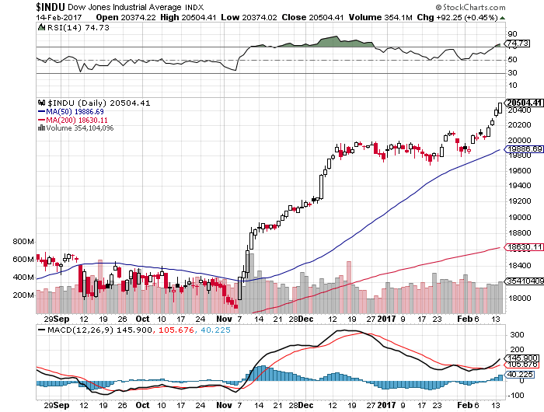
Dow Average-New High!

Slide 24
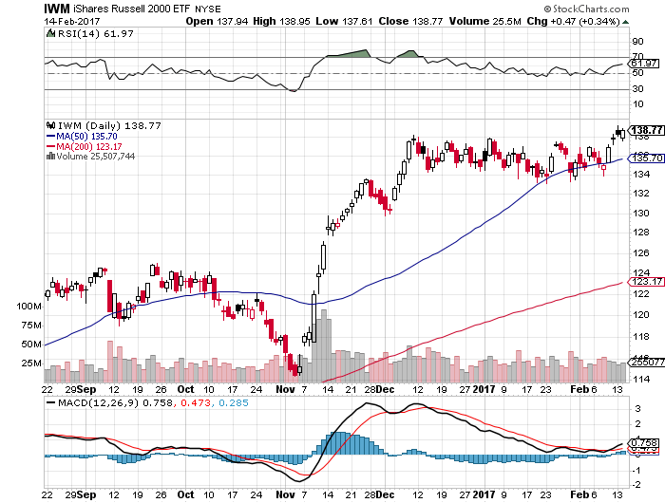
Russell 2000 (IWM)-New High took profits on long 11/$125-$128 vertical bear put spread 1/$129-$132 vertical bull call spread expired at maximum profit

Slide 25
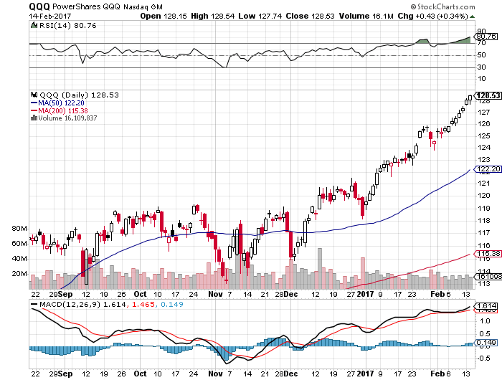
NASDAQ (QQQ)- This Year’s Leader

Slide 26
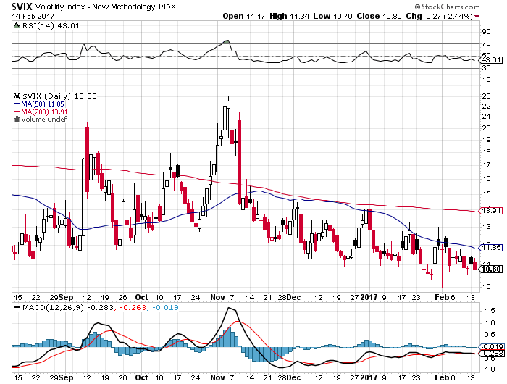
(VIX)-New Lows!

Slide 27
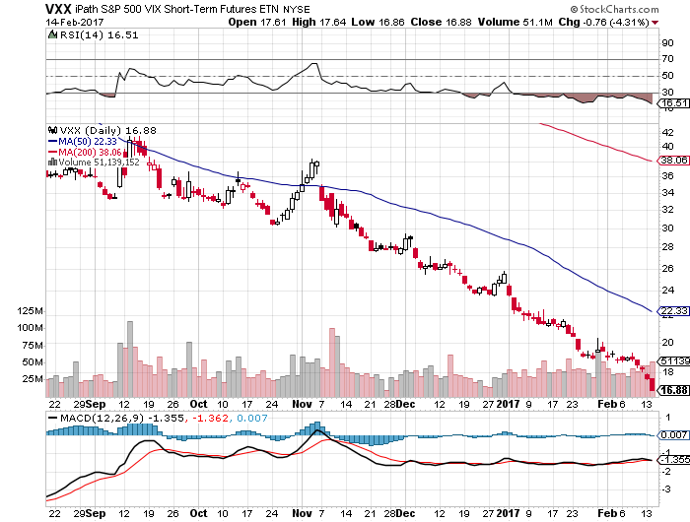
iPath S&P 500 VIX Short-Term Futures ETN (VXX) took profits on long 10/$27-$30 bull call spread

Slide 28
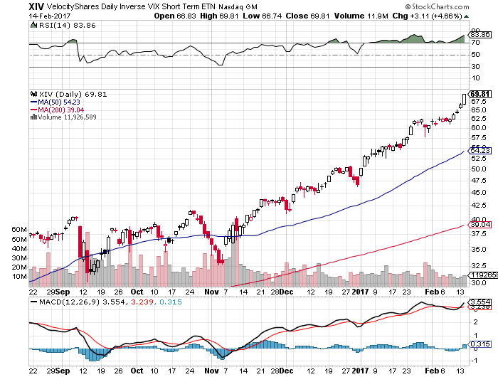
Velocity Shares Daily Inverse VIX Short Term ETN (XIV) took profits on long shares at $32.91 one of the most instantly profitable trades of 2016

Slide 29
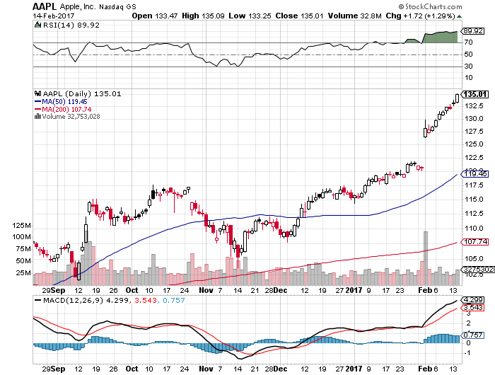
Apple (AAPL) –New High! took profits on long 1/$111-$114 bull call spread Q3 earnings upside surprise, Samsung self destructs, repatriation

Slide 30
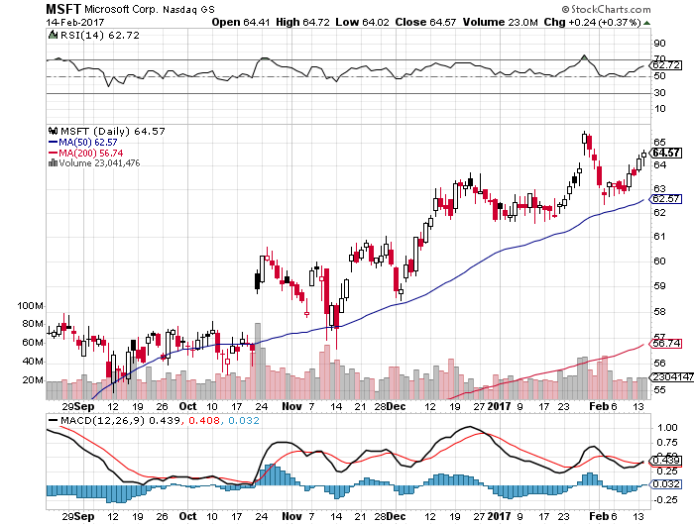
Microsoft (MSFT)

Slide 31
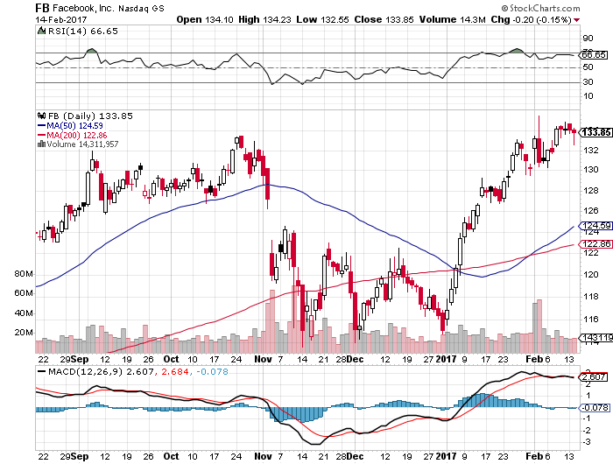
Facebook (FB)- took profits on long 11/$114-$117 vertical bull call spread

Slide 32
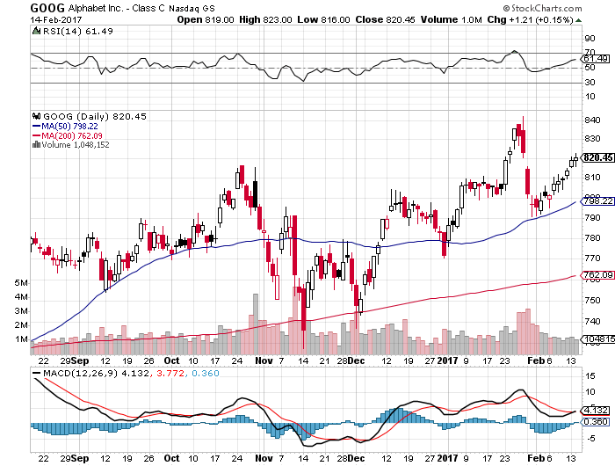
Alphabet (GOOG)-Earnings Shock took profits on long 1/$740-$760 vertical bull call spread

Slide 33
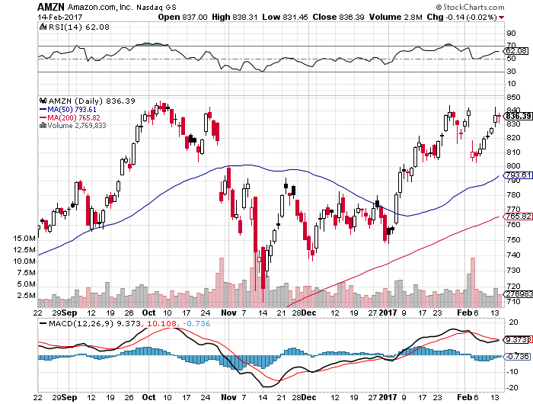
Amazon (AMZN)- took profits on long 1/$740-$760 vertical bull call spread earnings disaster-buy the dip

Slide 34
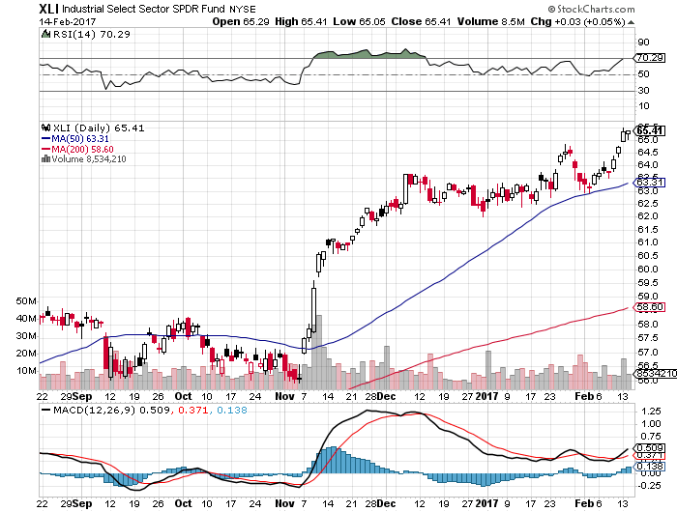
Industrials Sector SPDR (XLI)-Breakout (GE), (MMM), (UNP), (UTX), (BA), (HON)

Slide 35
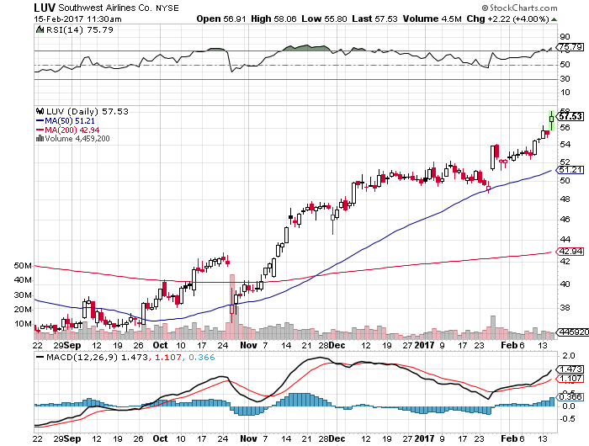
Southwest Airlines (LUV)- Warren Buffet’s Favorite Airline

Slide 36
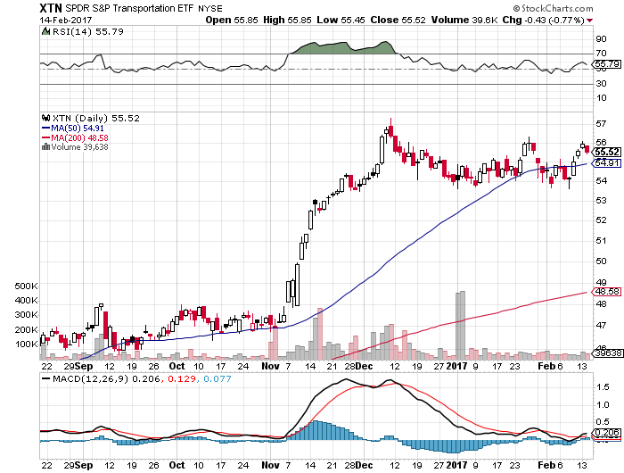
Transports Sector SPDR (XTN)- (ALGT), (ALK), (JBLU), (LUV), (CHRW), (DAL)

Slide 37
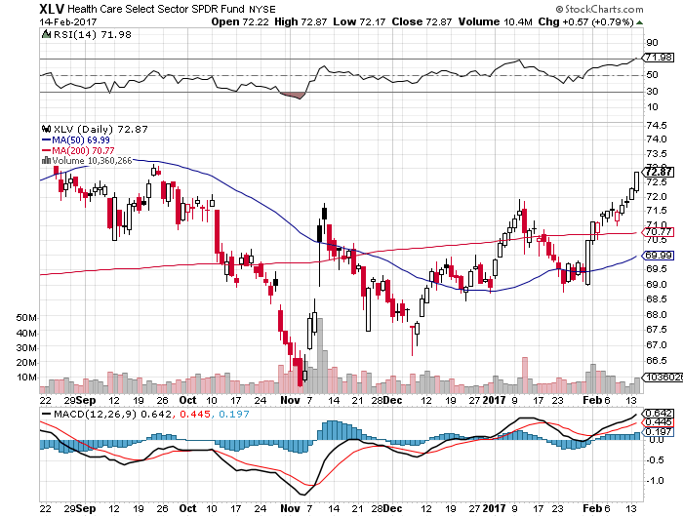
Health Care Sector (XLV), (RXL) (JNJ), (PFE), (MRK), (GILD), (ACT), (AMGN) “Getting away with murder”

Slide 38
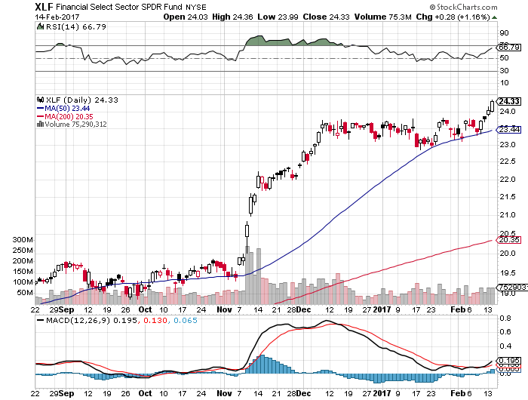
Financial Select SPDR (XLF)-Tarullo Resigns (BLK/B), (WFC), (JPM), (BAC), (C), (GS)

Slide 39
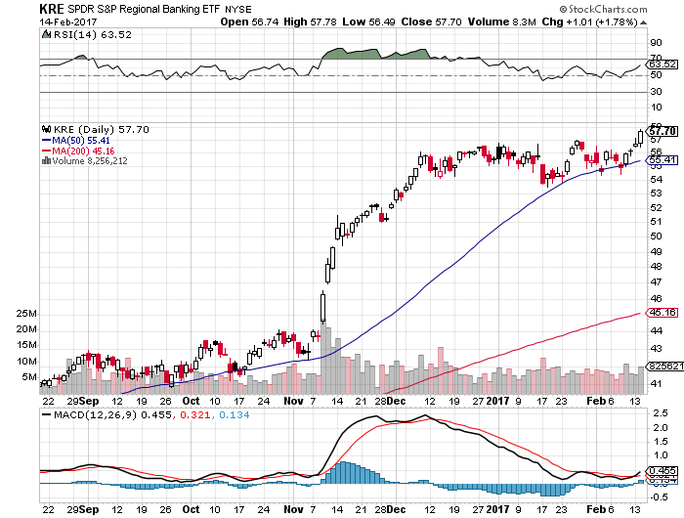
KRE Regional Bank ETF (KRE)-

Slide 40
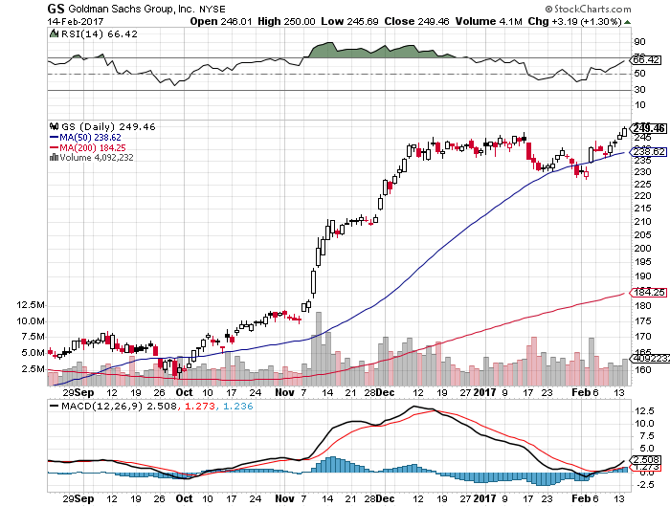
Goldman Sachs (GS)- took profits on long 2/$222.50-$227.50 vertical bull call spread most profitable trade of 2017

Slide 41
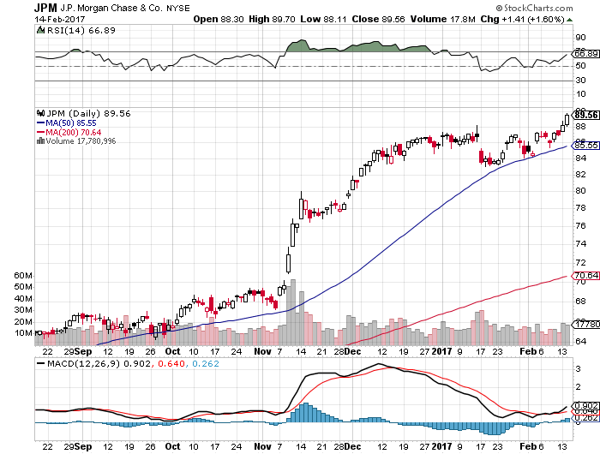
JP Morgan (JPM)-

Slide 42
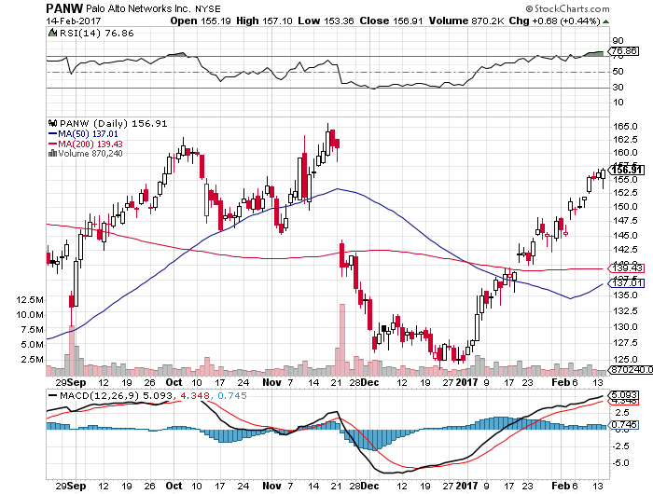
Palo Alto Networks (PANW)- took profits on long 1/$126-$129 bull call spread

Slide 43
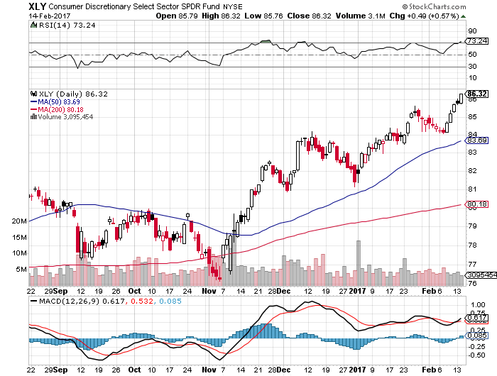
Consumer Discretionary SPDR (XLY) (DIS), (AMZN), (HD), (CMCSA), (MCD), (SBUX)

Slide 44
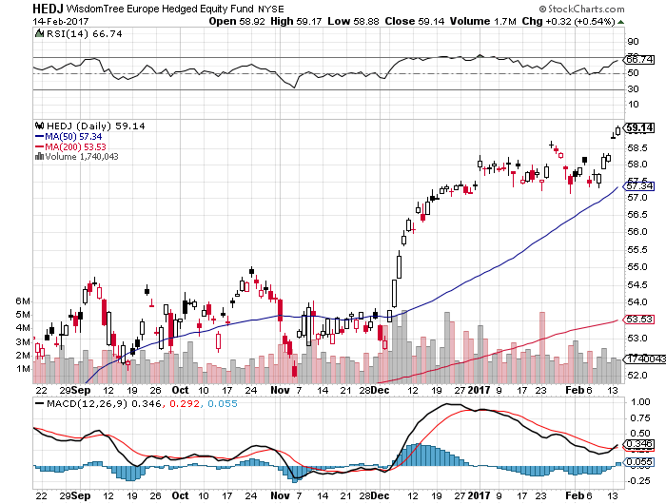
Europe Hedged Equity (HEDJ)-Euro Rally Headache

Slide 45
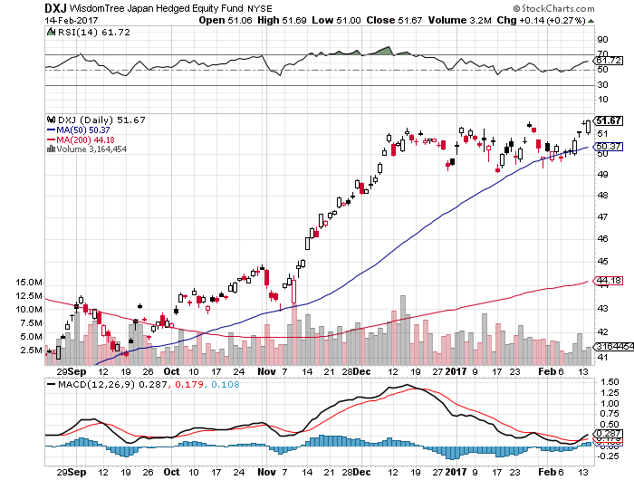
Japan (DXJ)-Yen Rally Headache

Slide 46
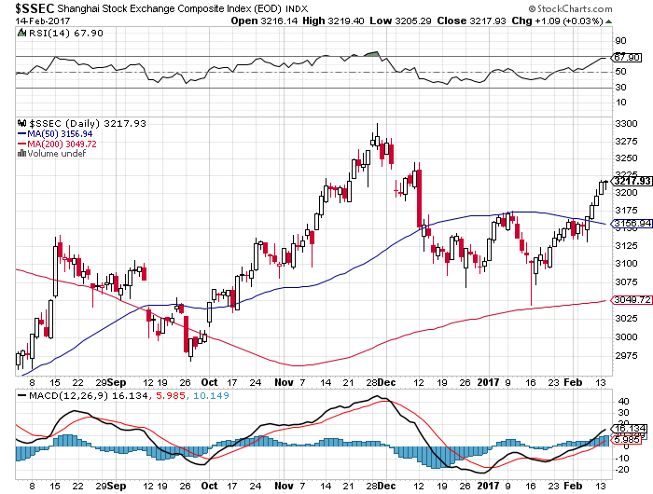
China ($SSEC)- Trade War Focus is Now on Mexico

Slide 47
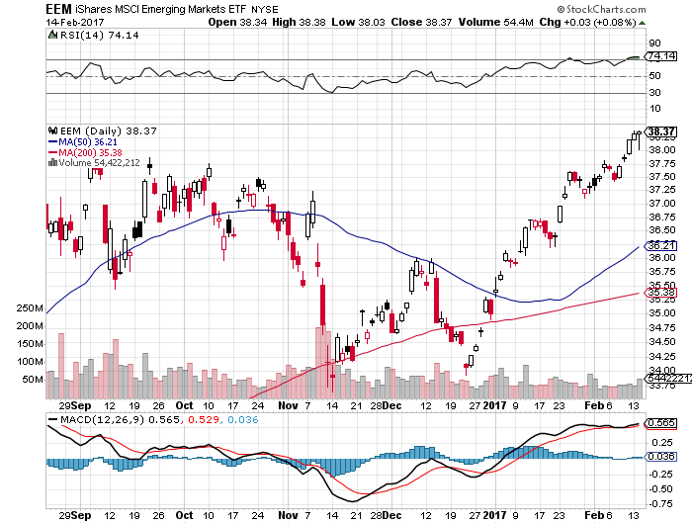
Emerging Markets (EEM)- Big Anti Trump Rally

Slide 48
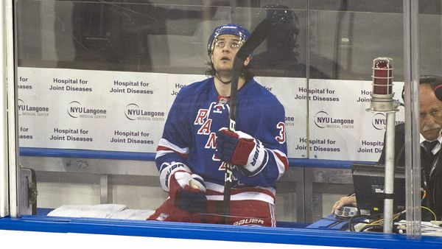
Bonds-Back in the Penalty Box
*“TRUMP OFF” rally fails, back to middle of the range *Longer term investors still desperate to get out, but the liquidity isn’t there *March 14-15 25 basis point Fed rate hike is gone, June 13-14 is now the earliest opportunity *2.65% is a key upside resistance point, targeting 3.0%, but could take many months to unfold *We are six months into a 10-20 year bear market in bonds, (TLT) should drop from $120 to under $100 in 2017 *On Feb 15, the US national debt topped $20 trillion for the first time, showing where the real long term problem is

Slide 49
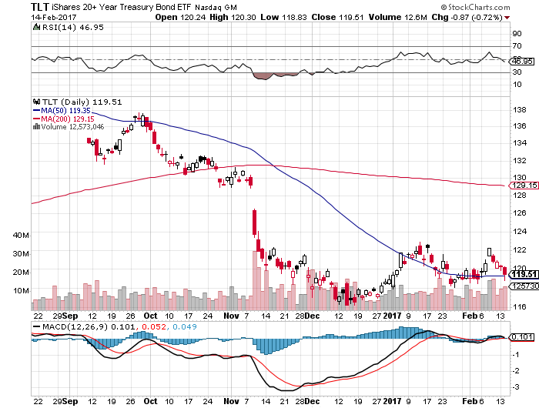
Ten Year Treasury ETF (TLT) 2.47% took profits on long 2/$126-$129 vertical bear put spread rolled forward and then took profits on the 3/$126-$129 vertical bear put spread on the “TRUMP OFF” rally

Slide 50
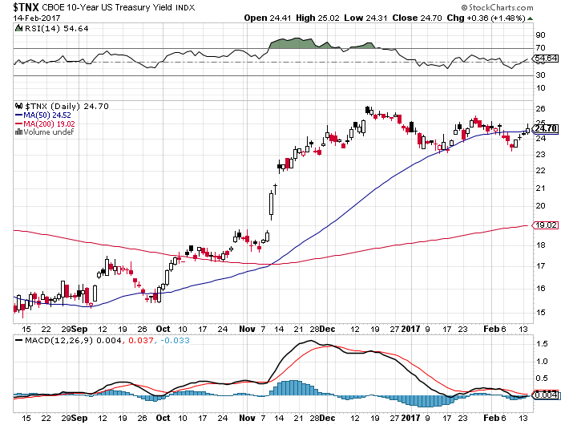
Ten Year Treasury Yield ($TNX) 2.47%

Slide 51
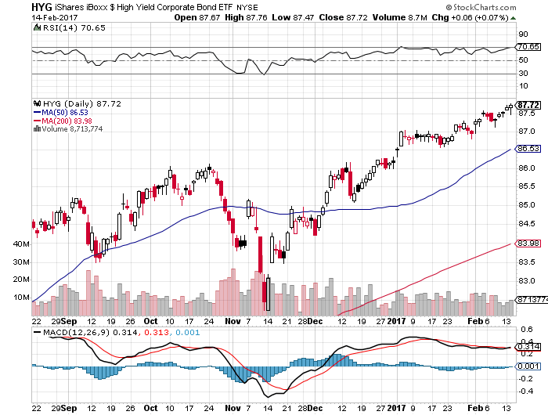
Junk Bonds (HYG) 5.19% Yield A Great Risk Coincident Indicator- Long Term “RISK ON” means new highs, buy all dips

Slide 52
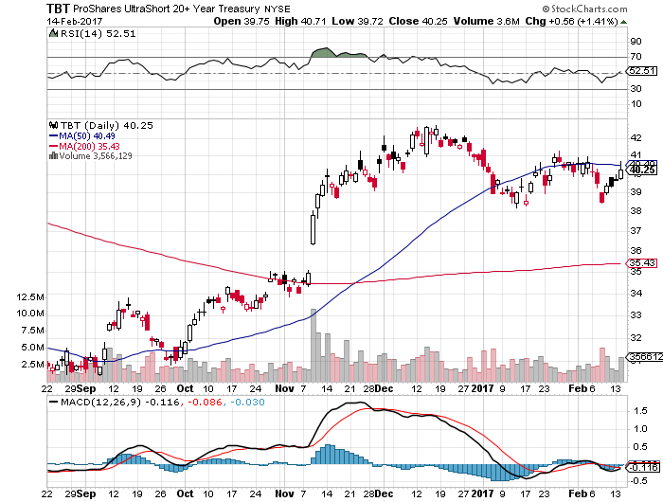
2X Short Treasuries (TBT)

Slide 53
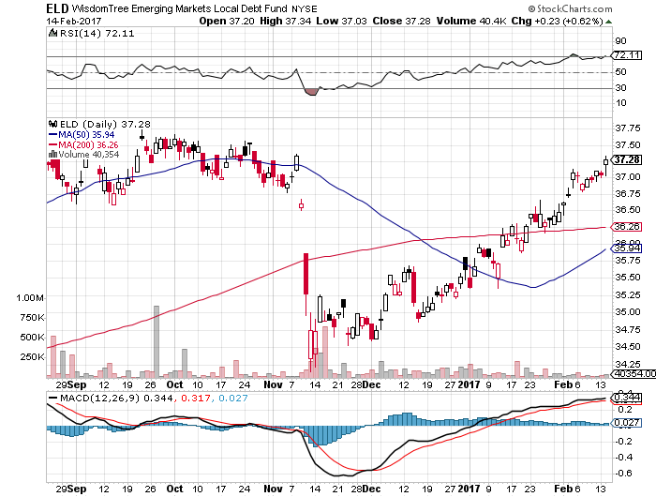
Emerging Market Debt (ELD) 5.77% Yield- crawling back with the anti-Trump trade

Slide 54
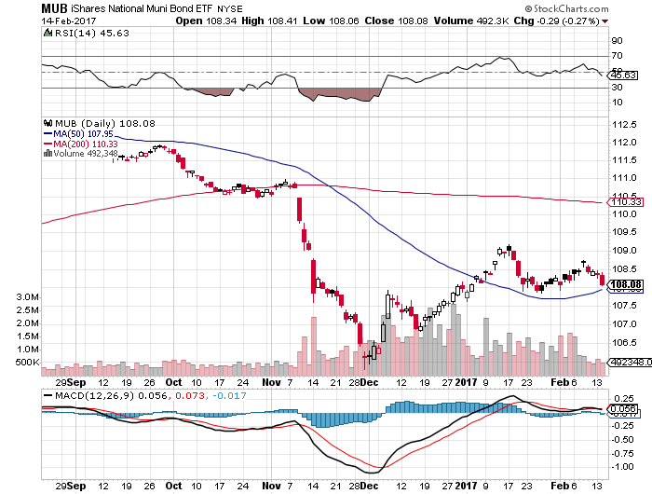
Municipal Bonds (MUB)-2.14% yield-almost doubled Mix of AAA, AA, and A rated bonds

Slide 55
Foreign Currencies-Tug of War
*President tries to talk down US dollar, with Peter Navarro saying the Euro is “grossly undervalued,” while the bond market says it is going up through rising rates *Weak economic data prompts Bundesbank head to say that QE will continue for the foreseeable future *Major Chinese effort to support renminbi *Moderating bond interest rates further sap dollar strength *Buy the dollar on any dips, but the March rate hike has fallen off the table

Slide 56
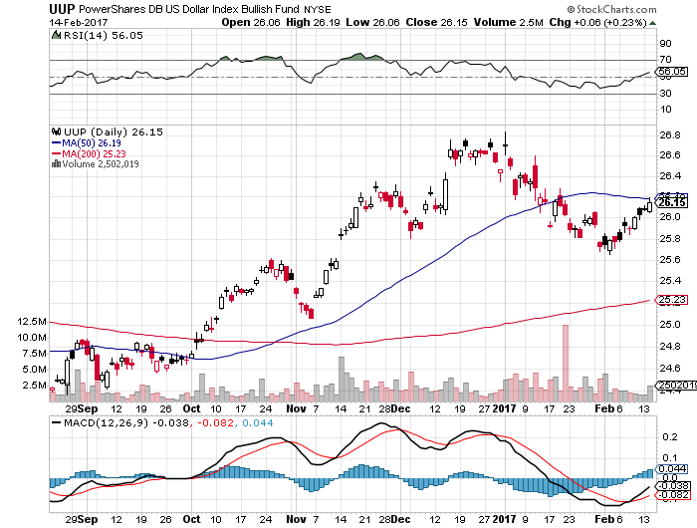
US Dollar Basket-(UUP)

Slide 57
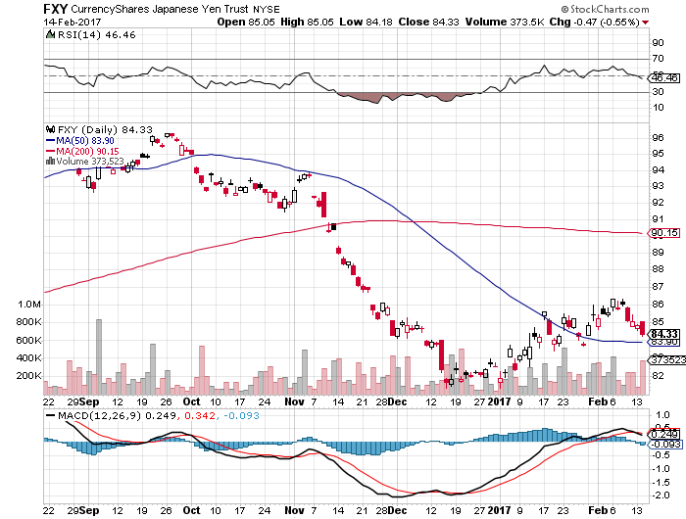
Japanese Yen (FXY)-Taking a Break Took profits on long 2/$88-$91 bear put spread

Slide 58
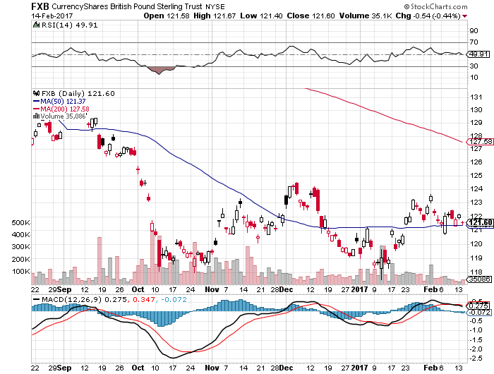
British Pound (FXB)-

Slide 59
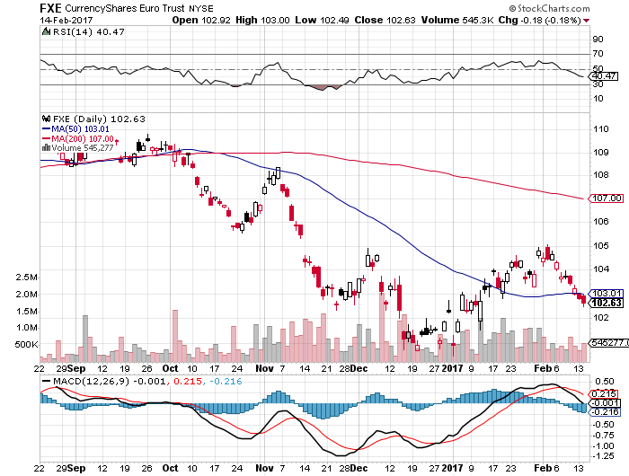
Euro ($XEU), (FXE), (EUO)- Bombs Away took profits on long 9/$112-$115 vertical bear put spread took profits on long 11/$110-$113 vertical bear put spread

Slide 60
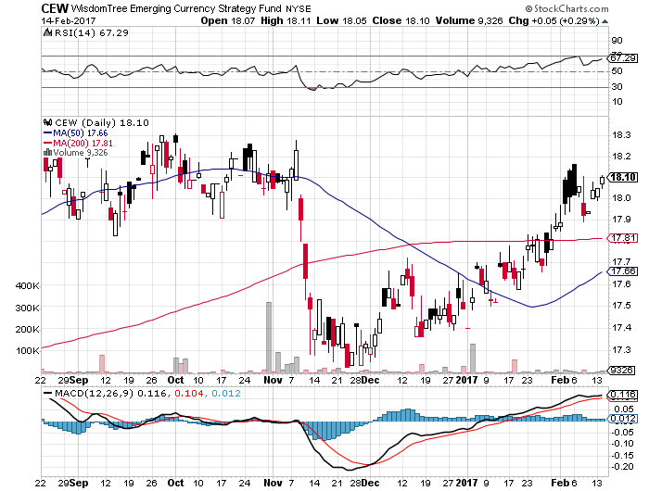
Emerging Market Currencies (CEW)

Slide 61
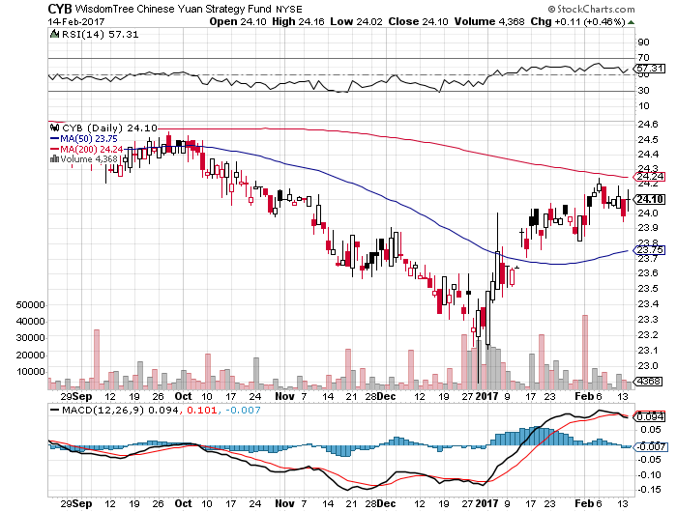
Chinese Yuan- (CYB)-

Slide 62
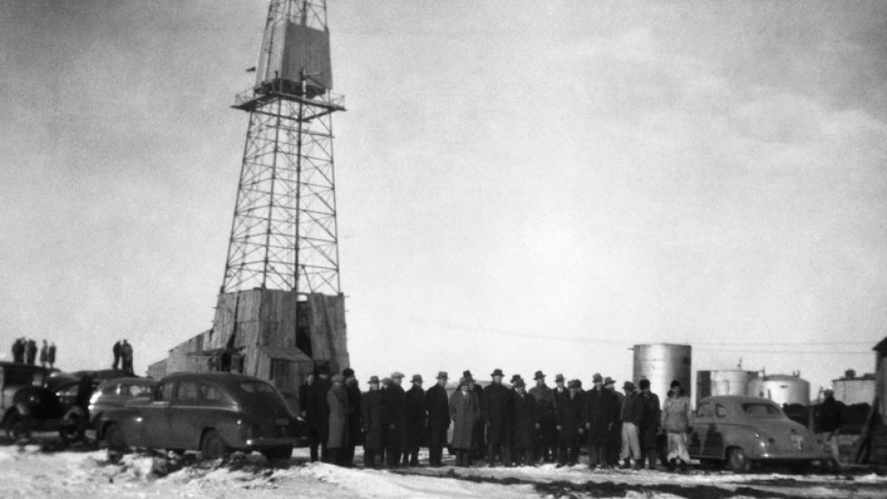
Energy-Topping Out
*The big surprise is that the new OPEC quotas are working better than expected *API Inventories explode by a record 14.2 million barrels and importers rush to beat border tax *Hedge fund oil long approaches 1 Billion barrels *Chinese SPR is full, ebbing global demand *Oil still stuck in $45-$60 one year range, trade the range

Slide 63
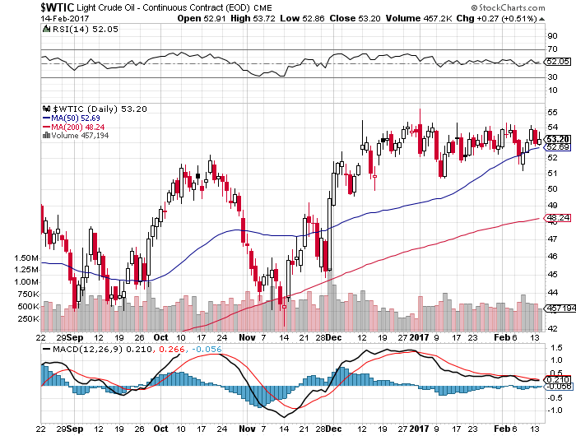
Oil-Top of Range-Topping Out

Slide 64
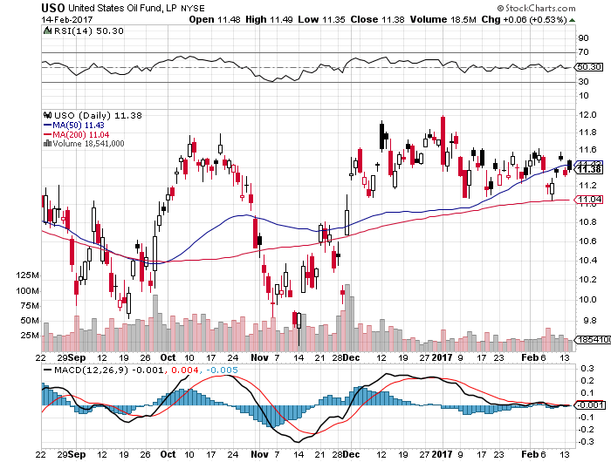
United States Oil Fund (USO) took profits on long (USO) 11/$12.50-$14.00 vertical bear put spread

Slide 65
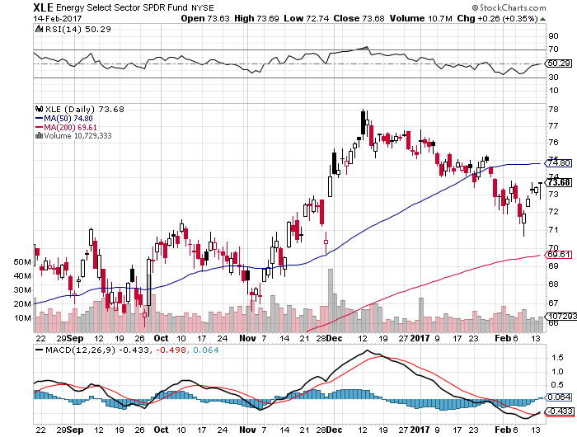
Energy Select Sector SPDR (XLE) (XOM), (CVX), (SLB), (KMI), (EOG), (COP)

Slide 66
Alerian MLP ETF (AMLP)- Basket Approach is the Only Safe Play Here

Slide 67
Exxon (XOM)-

Slide 68
Occidental Petroleum (OXY)-

Slide 69
Natural Gas (UNG)-Back to Bottom down 13% on first day of the year

Slide 70
Copper (COPX)-

Slide 71
US Steel (X)-Upside Breakout!

Slide 72
Precious Metals-The New Bull Market
*Hedge fund longs in gold hit new all time high, cash pouring into the (GLD) on a daily basis *Chinese New Years over, buyers are back *While China is dumping Treasury bonds to support the renminbi, it is keeping its gold *Speculative positions in gold back at new all time highs, especially with hedge funds *German government completes large repatriation of gold bullion from NY, 37% remains in the US

Slide 74
Gold (GLD)- took profits on long 11/$112-$115 vertical bull call spread took profits on long 2/$108-$111 vertical bull call spread

Slide 75
Market Vectors Gold Miners ETF- (GDX)

Slide 76
Silver (SLV)-

Slide 77
Silver Miners (SIL)-

Slide 78
Agriculture-More Bad News
*Cotton takes the lead in the ags, as Indian currency policy inadvertently creates a cotton shortage *New USDA forecasts are out, paint a fundamentally bearish picture for most Ag prices *Only severe winter weather is keeping prices from crashing to new lows *Mexico has been the largest buyer of US ags after China, will shift business to Brazil and Argentina in a trade war *Stay away

Slide 79
(CORN) –

Slide 80
(WEAT)-

Slide 81
(SOYB)-

Slide 82
Real Estate-Ticking Up
*Trump’s first act as president was to cancel a scheduled cut in FHA insurance premiums, causes mortgage applications to tank 3.2% *Rising home prices cut underwater homes in debt, increasing supply *California will build only 80,000 homes this year, versus demand of 180,000 *Home affordability falls to a seven-year low as prices keep rising *Russian money has suddenly started pouring into high end Miami *Homes are the best place to hide during an inflation surge *Case-Shiller is ticking up to 5.6%, with absolute prices hitting new all time high, your home equity could be the best investment of the year….again

Slide 84
November S&P 500/Case–Shiller Home Price Index +5.6% YOY, Seattle (+10.4%), Portland (10.1%), Denver (8.7%) still leaders absolute prices hit new all time high

Slide 85
General Growth Properties (GGP) Not Buying the Rally in Yields

Slide 86
US Home Construction Index (ITB) (DHI), (LEN), (PHM), (TOL), (NVR) Another Rising Rate Victim-But Becoming a Favorite Sector to Buy

Slide 87
Trade Sheet-The Complete Opposite So What Do We Do About All This?
*Stocks- buy dips, especially tech and financials *Bonds-sell rallies *Commodities-buy dips *Currencies-don’t bet against the long term trend *Precious Metals –buy gold and silver *Volatility-buy the dip *The Ags –stand aside *Real estate-stand aside

Slide 88
Next Strategy Webinar 12:00 EST Wednesday, March 1, 2017 San Francisco, CA
Good Luck and Good Trading!
Notes:
*

